Slide 1
HOW MUCH TIME DO WE HAVE?
GRADE 5
UNIT 10
Lesson 3 –
Grammar 2 and Song

Slide 4
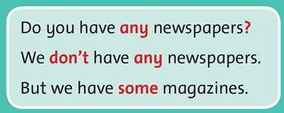

Slide 5
Use any for questions and negative sentences. Use some for positive sentences.
I have some magazines.
I don’t have any magazines.
Do you have any magazines?

Slide 6
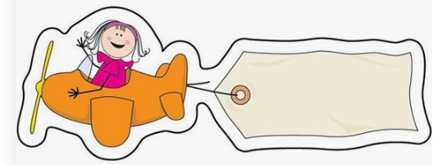
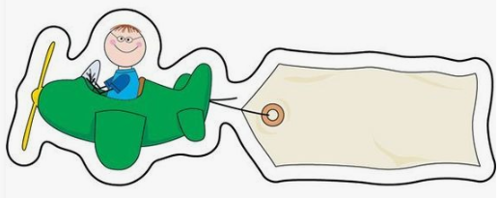
some
any

Slide 7
Do you have _____________ toothbrushes?
I don’t have _____________ toothbrushes.
I have ____________ toothpaste.
We would like ____________ chocolates.
Do they buy ____________ cookies?
any
any
some
some
any

Slide 8
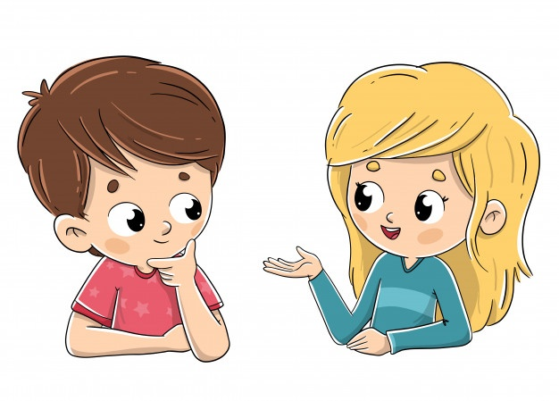
Ask and answer.
soap - magazine
toothbrushes - cookies
Do you have any soap?
Sorry, we don’t have any soap. But we have some shampoo.

Slide 9
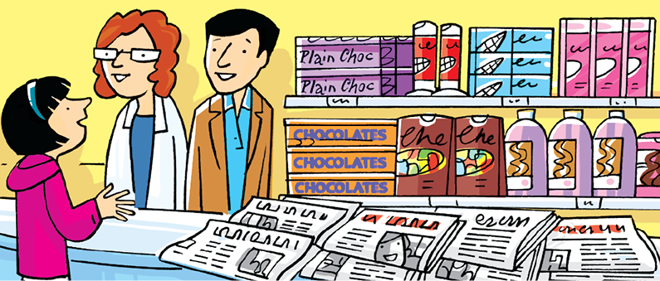
3. Now write about what is in the store
They have some shampoo. But they don’t have any soap.

Slide 10
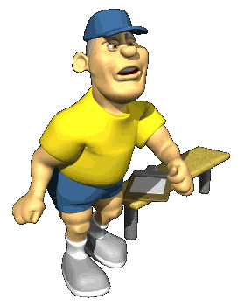
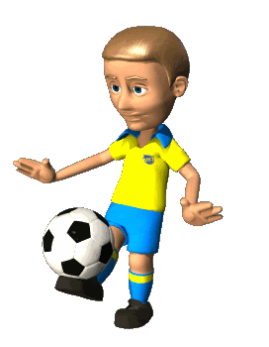
SOME or ANY
NEXT

Slide 11
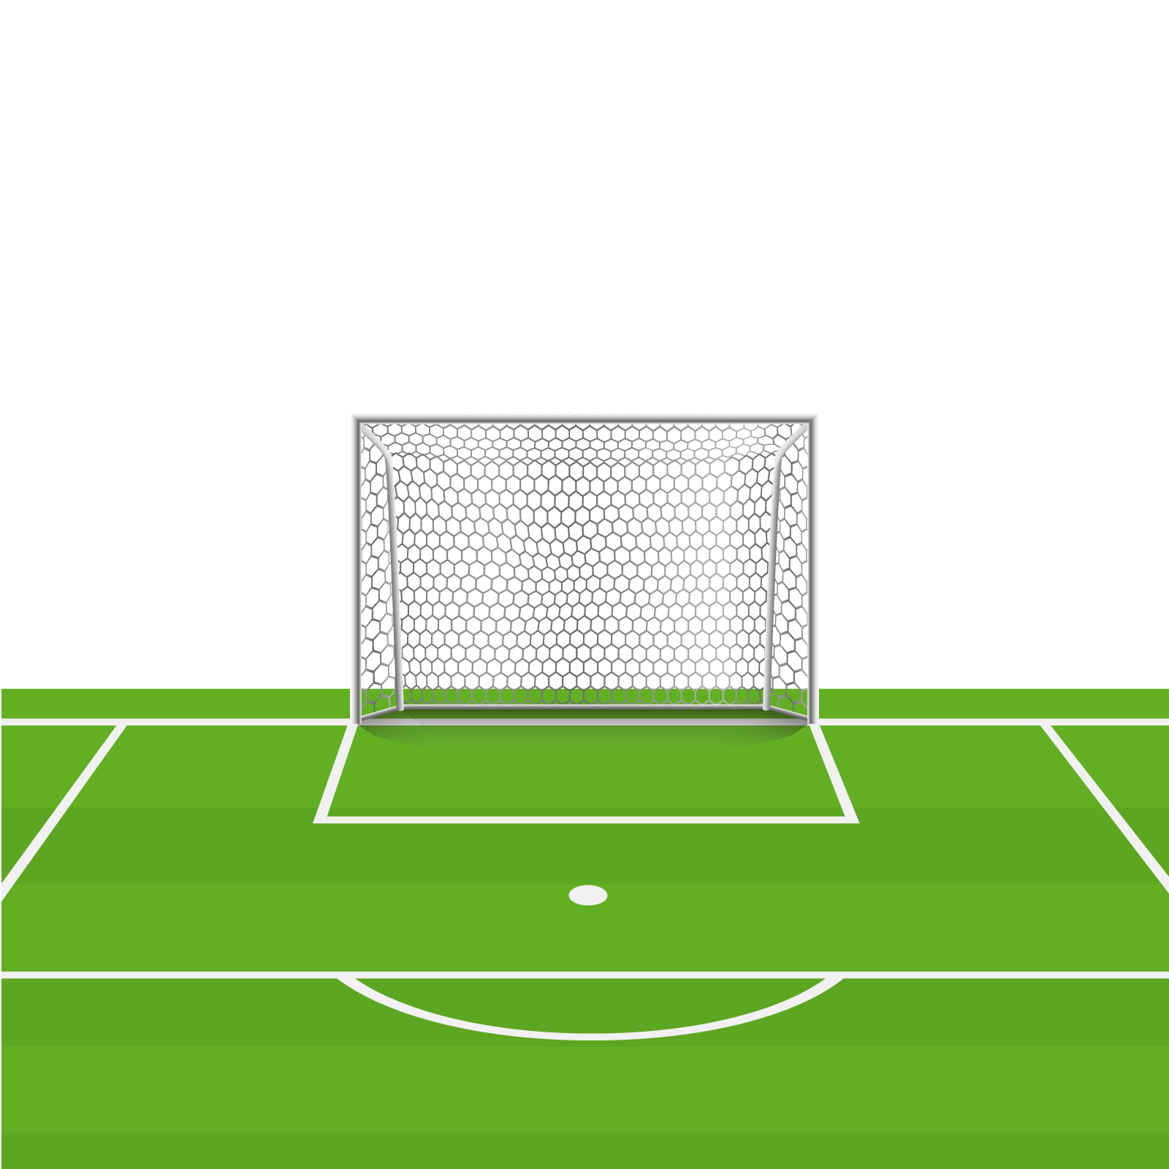
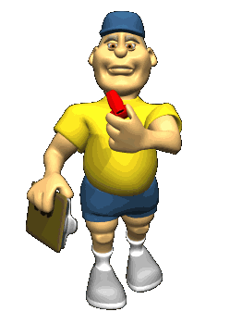
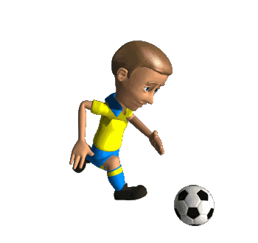
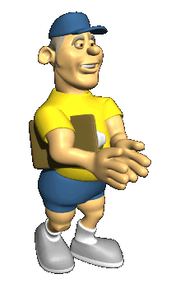
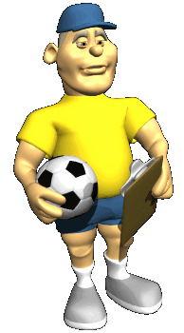
Choose the correct answer.
Do you have ……. soap?
NEXT
some
any

Slide 12
Choose the correct answer.
I don’t have any soap. But I have ….. shampoo.
NEXT
some
any

Slide 13
Choose the correct answer.
Do you have ….. milk chocolate?
NEXT
some
any

Slide 14
Choose the correct answer.
They have …. magazines for women.
NEXT
some
any

Slide 15
Choose the correct answer.
There are …. passengers on board.
NEXT
some
any

Slide 16
Choose the correct answer.
There aren’t …. passports in his bag.
NEXT
some
any

Slide 17
LISTEN AND POINT

Slide 19
LISTEN AND SING

Slide 21
GROUPWORK

Slide 22
PERFORMANCE TIME

Slide 23
WORKBOOK TIME

Slide 24
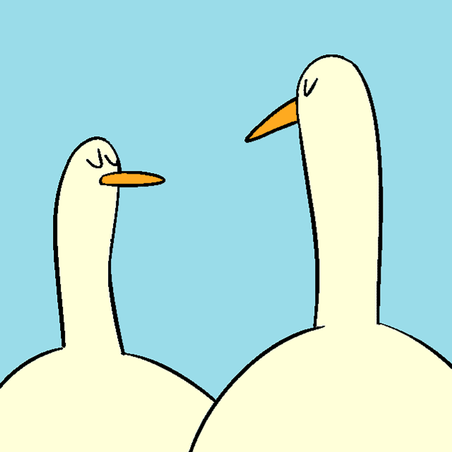
GOODBYE!!!

